Slide 1
Cobber Checkers
Milestone 5: Progress Update
BELLS

Slide 2

Reminder
We are creating Cobber Checkers!
This game will cure boredom on campus
The very first Cobber themed game will be created by us!

Slide 3
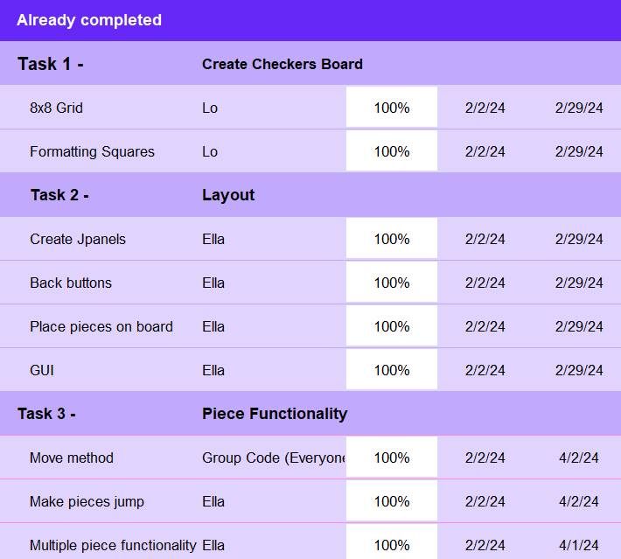
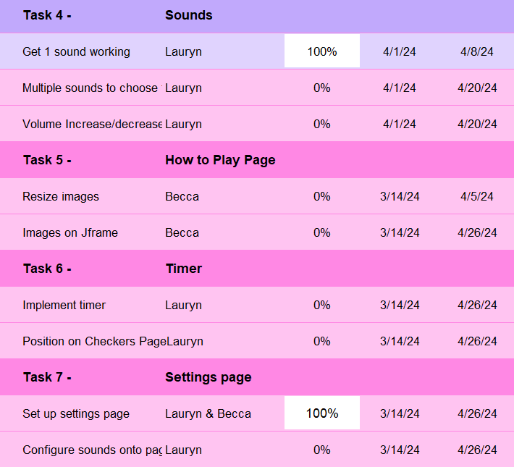
Gantt Chart / Timeline

Slide 4
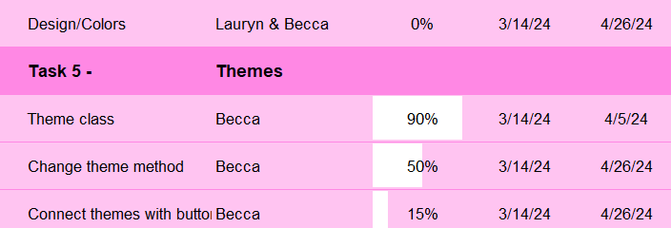
Gantt Chart / Timeline

Slide 5
Now, time for the code….

Slide 6
What’s going well
#1: Consistency
Everyone has been good at staying consistent with their coding tasks
#2 Code Organization:
Everyone is properly documenting code and including comments
#3 Progress:
We are staying on track to complete the project on time.

Slide 7
Challenges & Resolutions
Challenge #1 Communication:
We’ve struggled with consistent and timely communication. To resolve this, we would like to have more in-person conversations instead of texting/email.
Challenge #2 Group Meetings:
We’ve struggled to have consistent group meeting times that fit into everyone's schedule. We would like to start doing some meetings with only specific people needed for the task.
Challenge #3 Having access to updated files:
Our team has not been consistent with uploading updated project files to github. We would like to fix this by setting a day each week where we always update and combine files no matter the progress to make it less overwhelming.

Slide 8
We can’t wait to share the final product with you!

